Slide 1


Intro to Research at Penn Part II:
Finding Mentors & Projects
Mark Neuman, MD, MSc
Associate Faculty Director of Medical Student Scholarship and Research
neumanm@pennmedicine.upenn.edu

Slide 2
Agenda
Overview: finding research mentors and research projects
  Dr. Mark Neuman
Student/graduate panel
  Nate McLauchlan (MS2)
  Tim Cox (MS4)
  Sarah Landau (MS4)
  Clara Warden (MS4)
  Katie Auriemma, MD, MSHP (PSOM class of 2014; Pulmonary/CCM Fellow)
Discussion
  Dr. Horace DeLisser
  Dr. Joshua Baker

Slide 3
A research mentor: “That person directly responsible for the professional development of a research trainee.” (National Academy of Sciences, 1993)
Includes:
  Explicit conduct of scientific research (e.g., instrument use, research design, observational technique, and theoretical or cognitive frameworks)
  Implicit development of scientific standards (e.g., selection of research questions and data, authorship practices, and norms of communication, interpretation, and judgment).

Slide 4
The (scientific) research process
Define the problem
Review the literature
Define research questions & hypotheses
Define data collection strategy & plan analysis
Decide on the sample design
Choose the study design
Collect data
Analyze data
Write the report & share findings

Slide 5
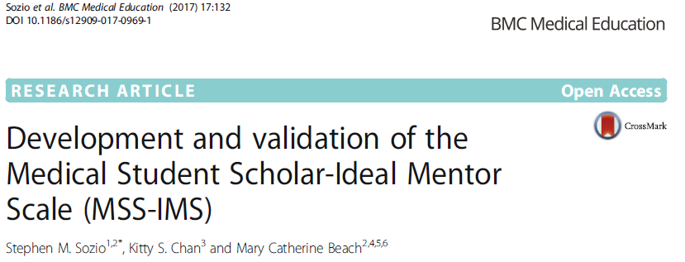
N= 598 medical students surveyed 2011-2016
Outcomes assessed
Overall satisfaction with mentor
Likelihood of future research
Abstract submitted to national/international meeting
Faculty rating of student project
Domain | Item
Mentor Advocacy | Gives proper credit to students
 | Advocates for my needs and interests
 | Gives me a sense of ownership over the project
Mentor Responsiveness | Responds to emails and phone calls
 | Meets with me on a regular basis and when I need to
Mentor Assistance | Helps me plan a timetable for my research
 | Shows me how to employ relevant research techniques
 | Helps me prepare for a presentation

Slide 6
Characteristics of successful mentor-mentee relationships (Straus SE et al, Acad Med 2013)
Construct | Description
Reciprocity | Bidirectional nature of mentoring, including consideration of strategies to make the relationship sustainable and mutually rewarding
Mutual respect | Respect for the mentor and mentee’s time, effort, and qualifications
Clear expectations | Expectations of the relationship are outlined at the onset and revisited over time; both mentor and mentee are held accountable to these expectations
Personal connection | Connection between the mentor and mentee around common interests
Shared values | Common ground around the mentor and mentee’s approach to research, clinical work, and life experiences

Slide 7
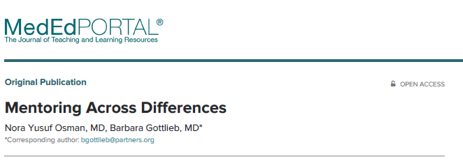
Osman et al., Med Ed Portal 2018: “the same social forces and interpersonal dynamics affecting all relationships can compromise mentoring relationships. This is especially true when there are issues that are compounded by structural disadvantage due to racism, gender bias, social class, and other discriminatory factors.”
Cross-difference mentor/mentee relationships succeed when:
  Participants can critically assess their assumptions.
  Participants can approach the experiences of colleagues who have different life experiences with a sense of curiosity.
  Participants can address differences openly.

Slide 8
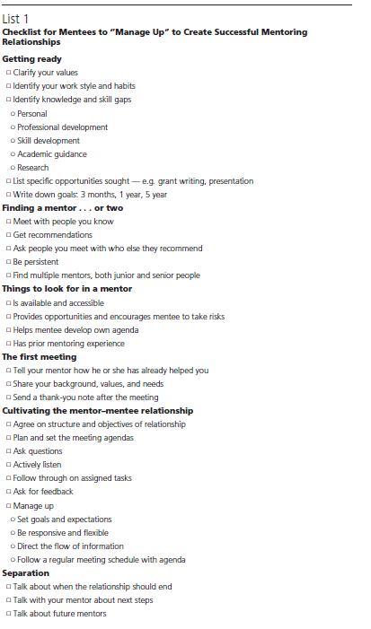
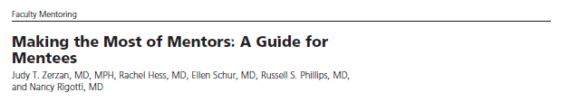
https://dicp.hms.harvard.edu/sites/default/files/files/2015/Mentoring/ResourcesForMentees/Zerzan%20Making%20the%20Most%20of%20Mentors%20A%20guide%20for%20mentees.pdf

Slide 9
Finding a project (Bettman, Circulation 2009)
Find people to help guide you (mentors, peers, others)
Find an area, field or project of personal interest
Find a defined, “do-able” project
  Consider non-human subjects research or exempt research
The project should be worth doing, the question worth answering
Balance your ideas and your independence with those of others
Also (MDN):
  How much of the research process will you get to touch? How much will you learn?
  Always: Quality >> Quantity

Slide 10
Funding for student research at PSOM
Multiple routes; depends on location of work (on campus vs elsewhere)
Mentor’s grants/discretionary funds
Extramural federal or foundation
On-campus fellowships or recurring programs through departments, centers, or school offices
Application timelines, duration of support, funding level vary
For applications made to the university by an external organization (NIH, foundation) on the applicant’s behalf, Penn’s Office of Research Services is the institution’s official representative in most instances (https://researchservices.upenn.edu/)

Slide 11
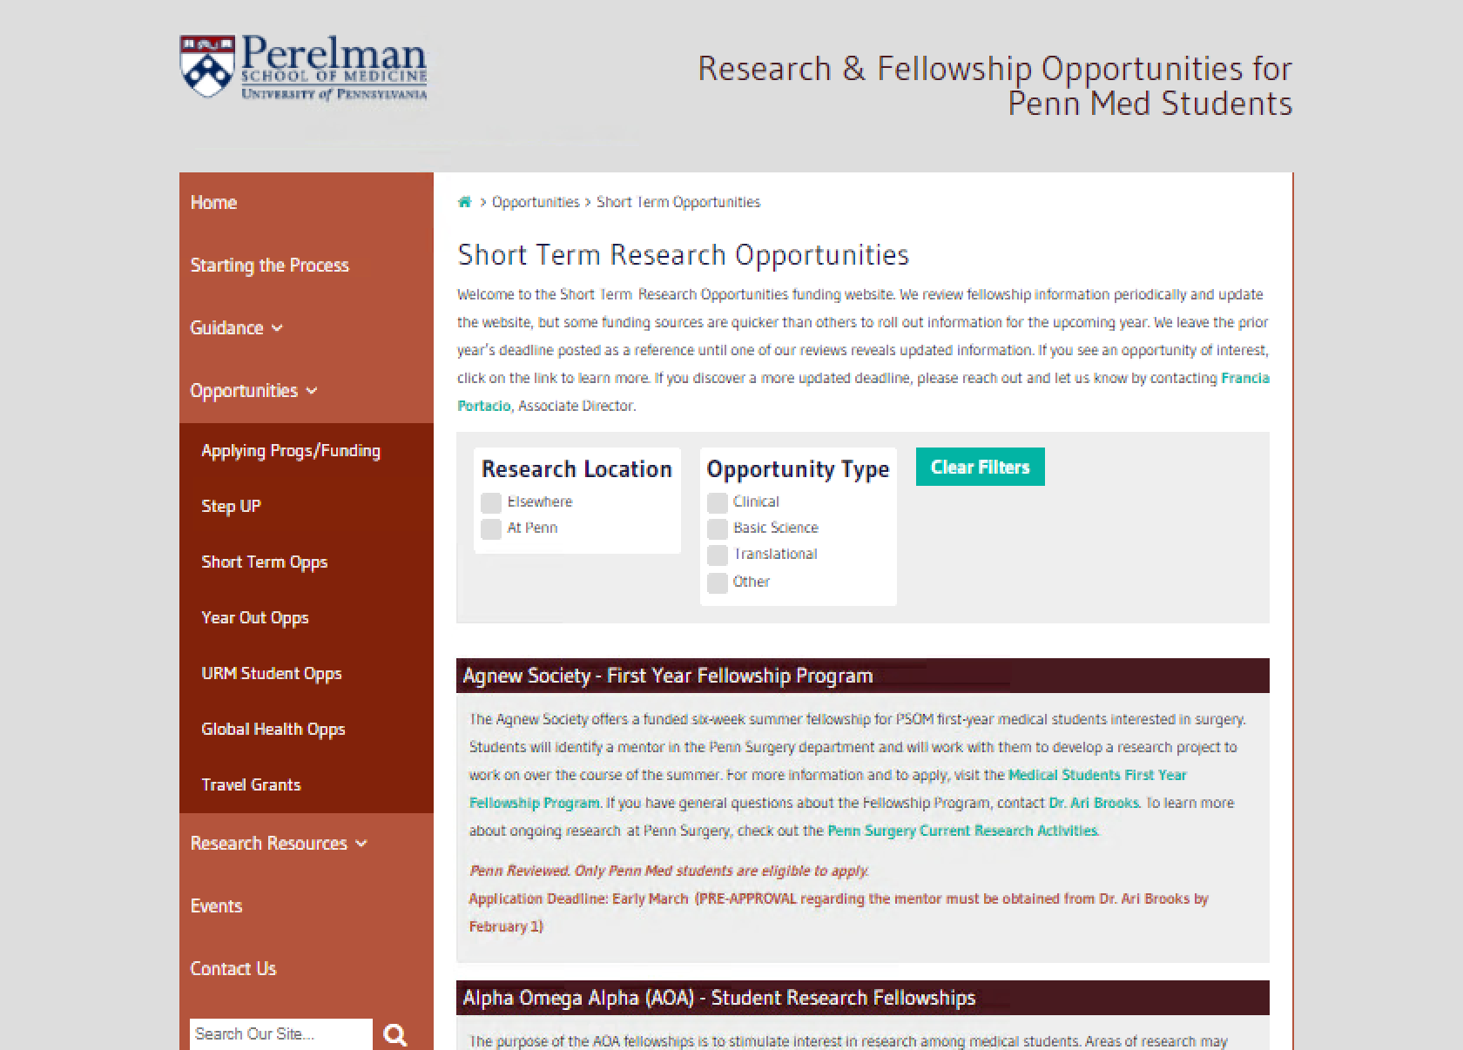
https://www.med.upenn.edu/mdresearchopps/
Summer/Short-term funding
  93 opps (28 at Penn/65 external)
  Apps due Dec – March
  Stipend ranges: $1,000 - $6,000
Year-out
  34 opps total (15 at Penn/19 external)
  Apps due Oct - May
  Stipend ranges: $24,000 - $45,000
URM
  25 opps total (7 Penn/18 external)
  Typical due dates: Jan - March
  Comparable stipends vs other short-term/year out

Slide 12
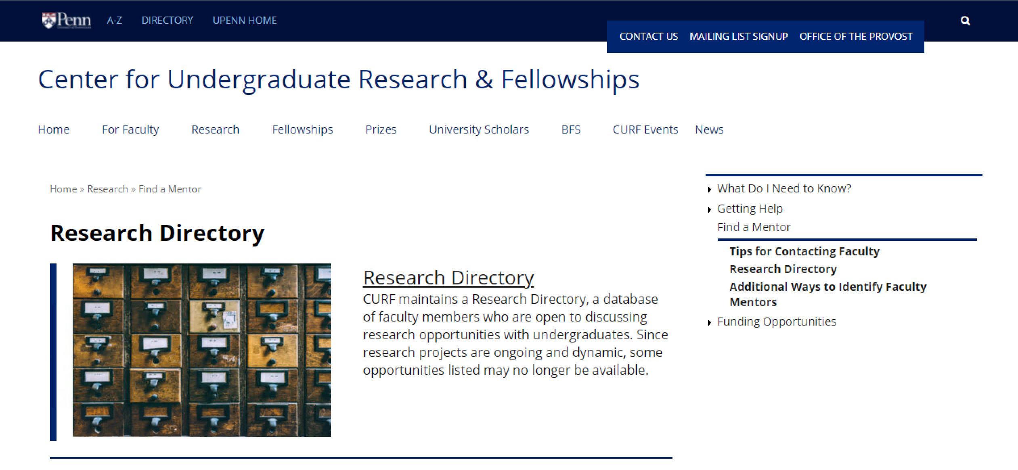
https://www.curf.upenn.edu/research/find-mentor/research-opportunity-directory

Slide 13
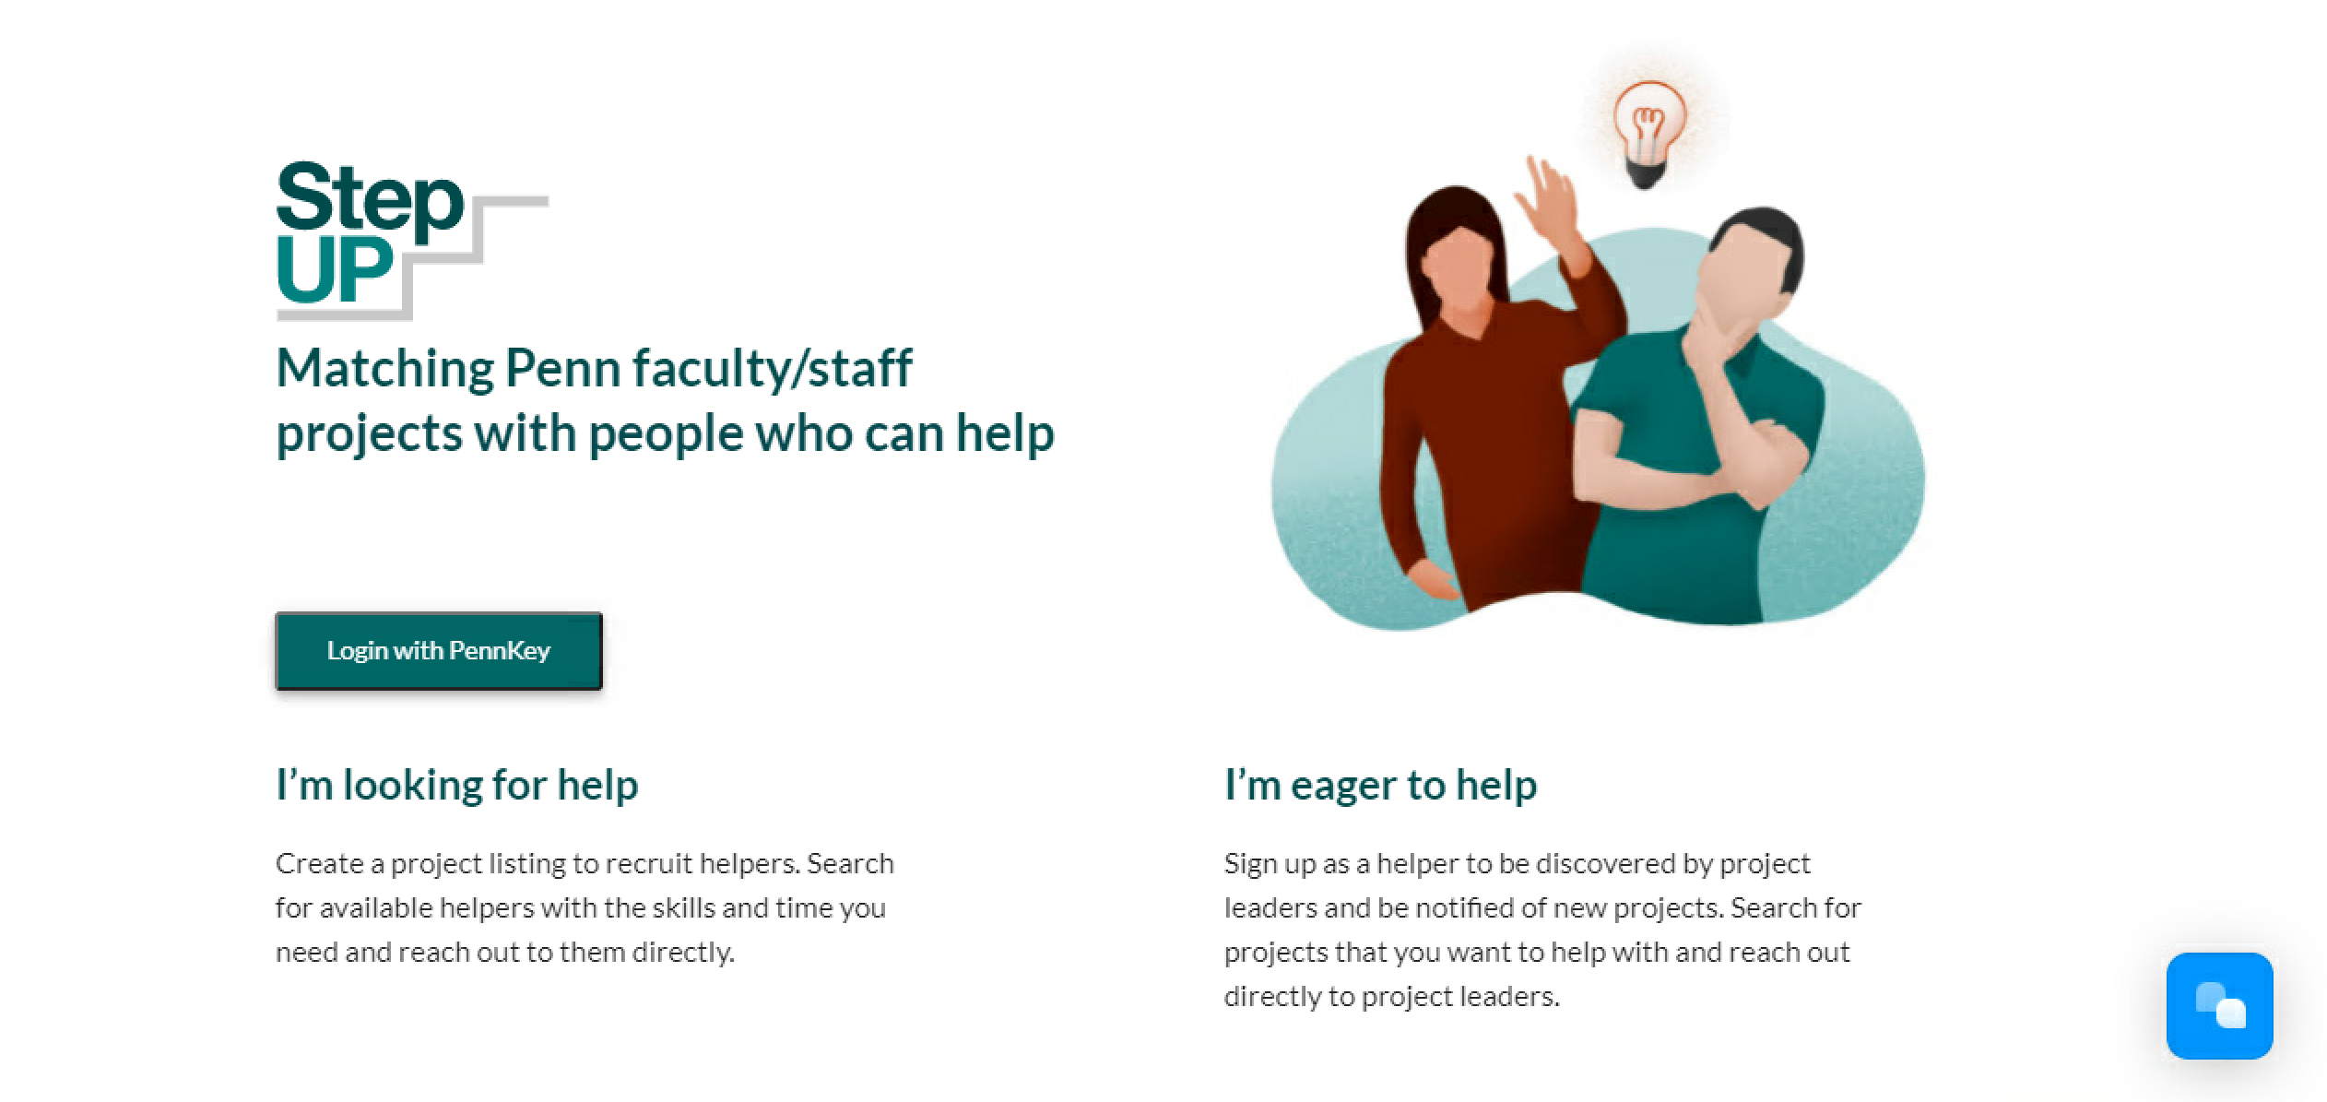
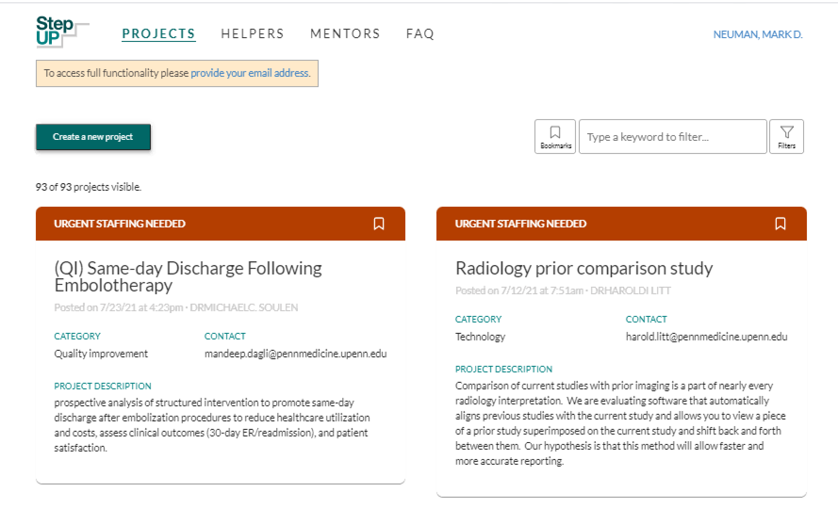
https://stepup.uphs.upenn.edu/

Slide 14
Discussion
Panelists
  Nate McLauchlan (MS2)
  Tim Cox (MS4)
  Sarah Landau (MS4)
  Clara Warden (MS4)
  Katie Auriemma (PSOM class of 2014; Pulmonary/CCM Fellow)
Discussants
  Horace DeLisser, MD, Associate Professor of Medicine and Associate Dean for Diversity & Inclusion in Undergraduate Medical Education
    Program Director, NHLBI Short Term Grant for African-American, Hispanic/Latino, and/or Native American Students
  Joshua Baker, MD, MSCE, Associate Professor of Medicine
    Director Center For Clinical Epidemiology and Biostatistics Stolley Summer Research Fellowship at Penn

Slide 15
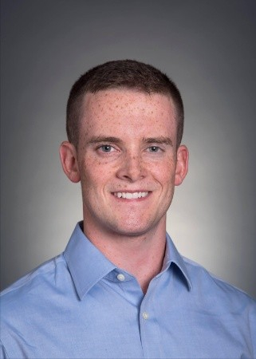
Nate McLauchlan (MS2)
Nate is currently working with Dr. Jeremy Cannon on surgical management of traumatic hemothorax.

Slide 16
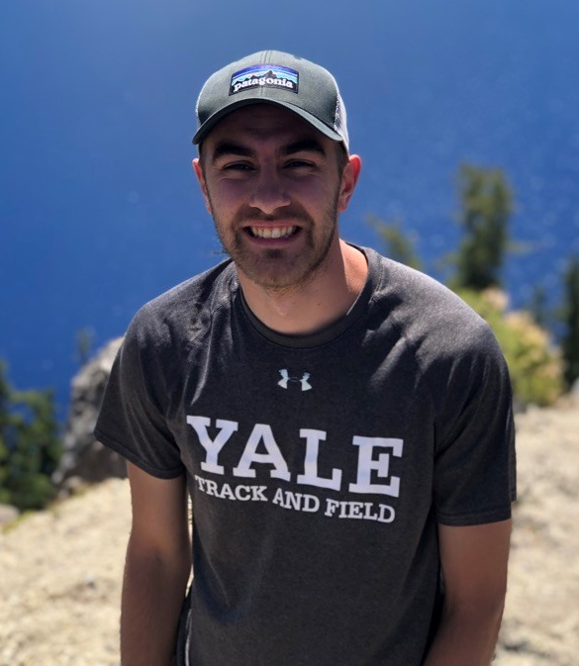
Tim Cox (MS4)
MD/PhD; applied into PhD program after matriculation
Tim worked with PI’s, Dr. Virginia Lee and Dr. Christoph Thaiss, investigating aging-microbiome and neurodegeneration-metabolism interactions.

Slide 17
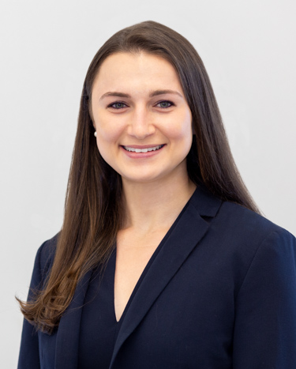
Sarah Landau (MS4)
Over the past 3 years, Sarah has been working with Dr. Rachel Kelz and the Center for Surgery and Health Economics conducting various research projects focused on health services, surgical outcomes, and surgical education.

Slide 18
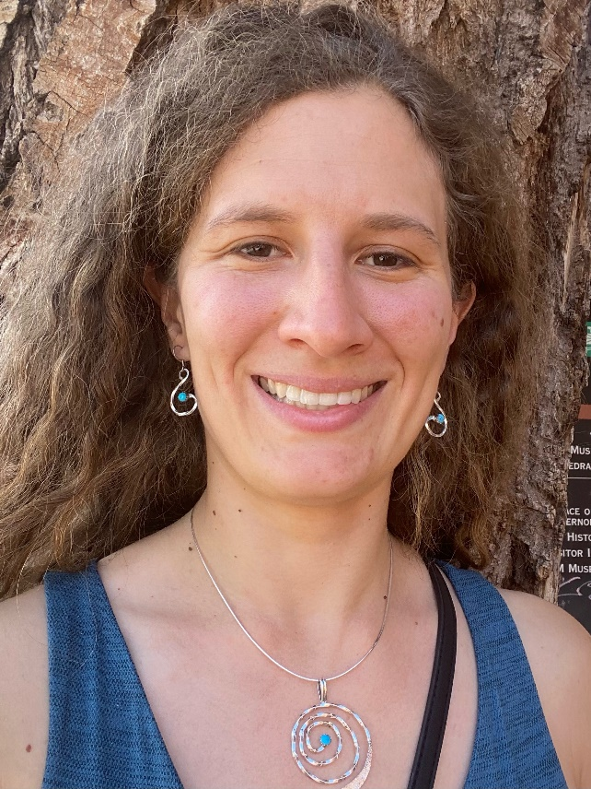
Clara Warden(MS4)
During her MS1 summer, Clara worked with Dr. Jordan Swanson to examine the relationship between socioeconomic status and incidence of orofacial clefts.
For her scholarly pursuit, Clara is looking forward to working with Dr. Dovie Watson to explore risk factors for poor HIV health outcomes among people living with HIV in Guatemala.

Slide 19
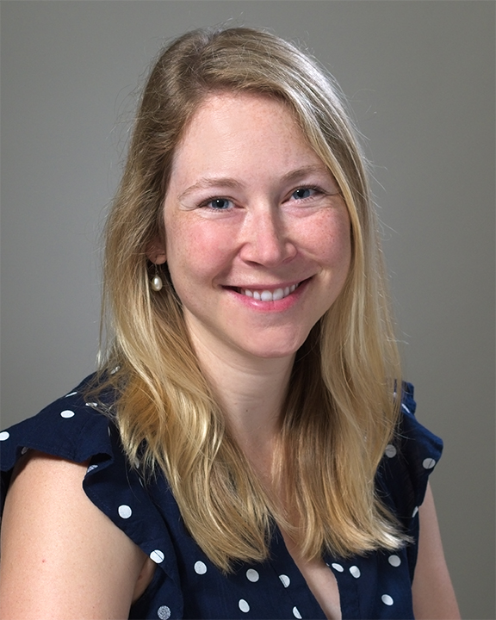
Katie Auriemma, MD, MSHP
PSOM class of 2014
Fellow, Pulmonary and Critical Care Medicine
Katie was supported by a Doris Duke Clinical Research Fellowship to work with Dr. Scott Halpern to understand the burden of decision making experienced by clinicians in the medical intensive care unit.

Slide 20
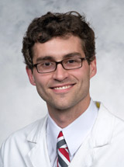
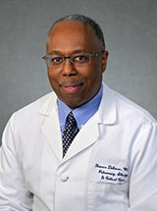
Discussion/Q&A
Joshua F. Baker, MD, MSCE
Associate Professor of Medicine at the Hospital of the University of Pennsylvania and the Veteran's Administration Medical Center
Horace M. DeLisser, MD
Associate Professor of Medicine and Associate Dean for Diversity & Inclusion in Undergraduate Medical Education

Slide 21

Contact
Mark Neuman: neumanm@pennmedicine.upenn.edu
Francia Portacio: francia.portacio@pennmedicine.upenn.edu
Website: https://www.med.upenn.edu/mdresearchopps/

